Slide 1
Covid-19 in Mexico City
Alexis Ángeles
David Escudero
Carlos Hernandez
Rebeca Osorio
Juan Carlos Reyes

Slide 2
Content
DESCRIPTION
ANALYSIS
DATA INFORMATION
TECHNOLOGIES

Slide 3
COVID 19
Coronavirus disease 2019 (COVID-19) is a viral respiratory illness caused by severe acute respiratory syndrome coronavirus 2 (SARS-CoV-2), a single-stranded RNA virus
https://www.cdc.gov/coronavirus/2019-ncov/symptoms-testing/symptoms.html

Slide 4

COVID 19 clinical presentation
hsds
Asymptomatic Infection
Absence of clinical signs and symptoms
hsds
Mild Infection
Upper airway symptoms such as fever, fatigue, myalgia, cough, sore throat, runny nose and sneezing.
hsds
Moderate Infection
Clinical signs of pneumonia.
The clinical deterioration usually occurs in a week with the development of dyspnea and hypoxemia (Sa02 <94%)
hsds
Severe Infection
hsds
Critical Infection
Patients can quickly deteriorate to acute respiratory distress syndrome or respiratory failure
https://www.cdc.gov/coronavirus/2019-ncov/symptoms-testing/symptoms.html

Slide 5
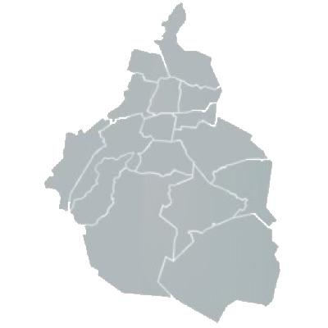
COVID 19 in Mexico City
COVID - 19 is affecting globally, not only for healthy reasons, economic, social and political impacts are being shown all around the world. Particularly for Mexico City:
Doctors say hospitals around Mexico City reached capacity rapidly. Additionally, it is a "public belief" that is you need to be treated in a public institution; the expected result is worse than if you are treated on a private Hospital.

Slide 6

Questions to be answered
Trying to eliminate this "Public belief" and using data from patients in Mexico City we will to try to predict the outcome from those patients which arrive to a public hospital to be treated with COVID-19 disease
Hospitals should dedicate resources on a 1st, 2nd or 3rd level to the patient to help him/her getting better?
JUPITER
Jupiter is a gas giant and the biggest planet
MARS
Mars is actually a very cold place

Slide 7
DATABASE
01 | Data Gathering
 | The information was gathered from patients that arrived to the Emergency Room in a Hospital in Mexico City
02 | Data Exploration
 | Database exploration was performed in a logic traceable steps in order to have analysis complete
03 | Data Cleaning
 | The Cleaning was performed using Jupyter Notebook in order to create clusters for out final algorithm

Slide 8
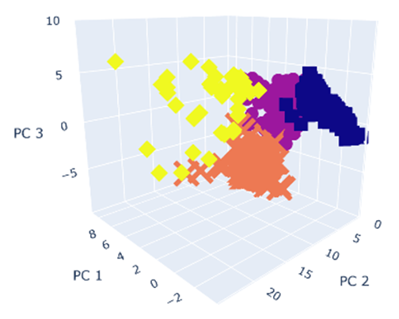
Machine Learning Models
Clustering Model
Classify patients to prioritize health care based on patient’s health data and probable outcome.
01 | Data Prepocessing
02 | Feature Engineering: Elbow Curve & PCA
03 | Plotting & Loading Data
4
Clusters

Slide 9
Machine Learning Process
01
02
Logistic Regression ML Model
Accuracy
Model preparation, training and testing

Slide 10




Technologies Used
1
3
2
4
Data Cleaning and analysis
Database Storage
Machine Learning
Dashboard

